Slide 1

EDM Genre Predictor
Eric Meyers
General Assembly PT Data Science

Slide 2
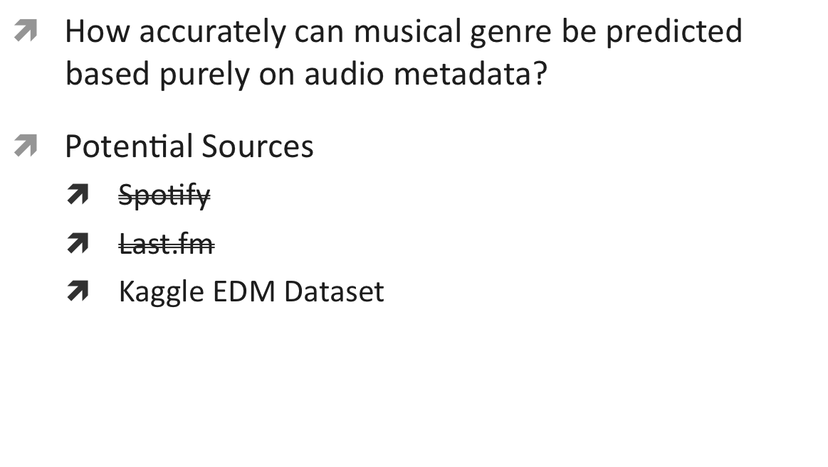
Problem Statement

Slide 3
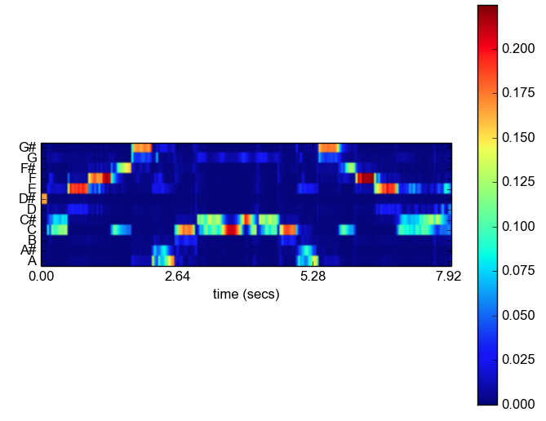
Metrics & Assumptions
70 Attributes & 23 Classes!
Spotlight: Chromagram
Attribute Families – input signal statistics
  Spectrogram: spectrum
  Chromagram: pitch class
  Energy: signal values (sum of squares)
  Tempo: Beats Per Min (BPM)
  Frequency: distribution
Target: 23 Subgenres
Assumptions:
  Clean data (0 null values)
  Even sample sizes
  “Correct” categorization

Slide 4
Approach & Process
Main Challenges:
  Attribute Overload! (70)
  Subgenre Overload! (23)
How to balance feature selection with unique categorization?
Exploratory Data Analysis
Model Selection
  Classification: KNN
Model Optimization
  Feature Selection
  K Value
  Train/Test Split
Alternate Cluster Methods
  K-Means Classifier
  Apply Domain Expertise

Slide 5
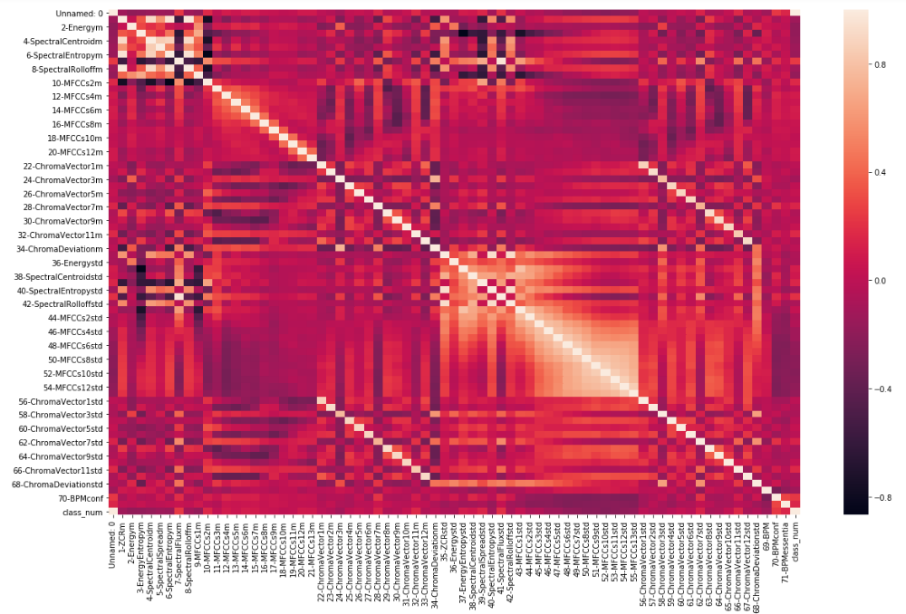
Model
EDA: Feature Correlation

Slide 6
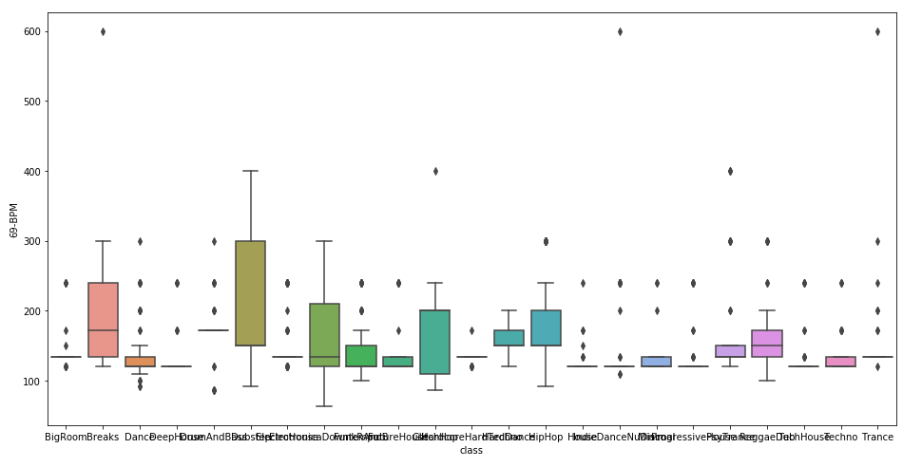
Model
EDA: Feature Selection

Slide 7
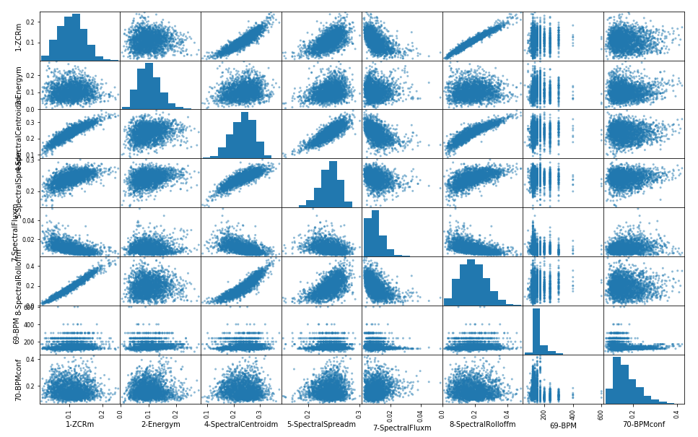
Model
EDA: Feature Selection

Slide 8
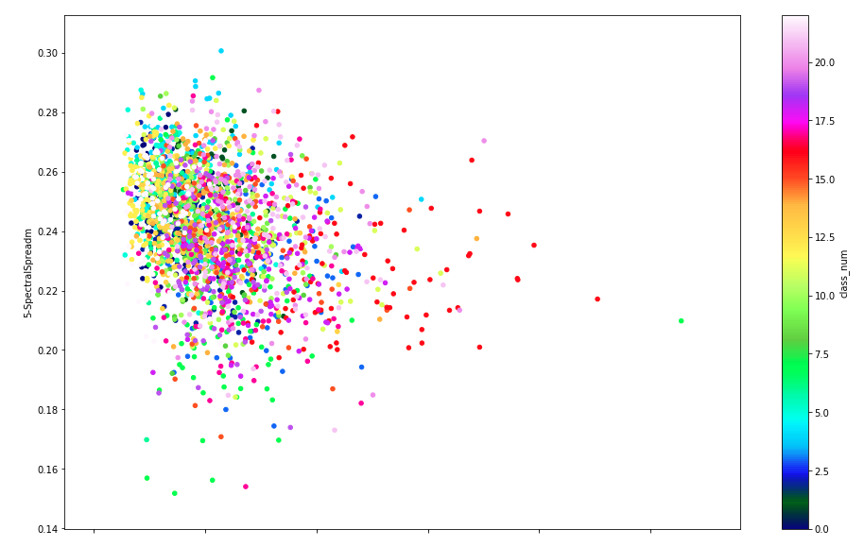
Model
EDA: Feature Selection

Slide 9
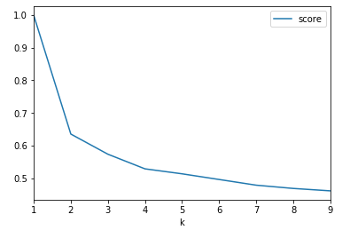
Model
K-Value

Slide 10
Alternative Approaches
Approach #2
Approach #3
Use K-Means to reclassify sub genre & refit KNN
  Ignore given subgenres
  Iterate through K Clusters
  Assess success with Silhouette Scores
Manual intervention in sub genre classification with domain expertise
  Adds “feel” to the model
  Uneven subgenre sample
    Weighted KNN (Distance)

Slide 11
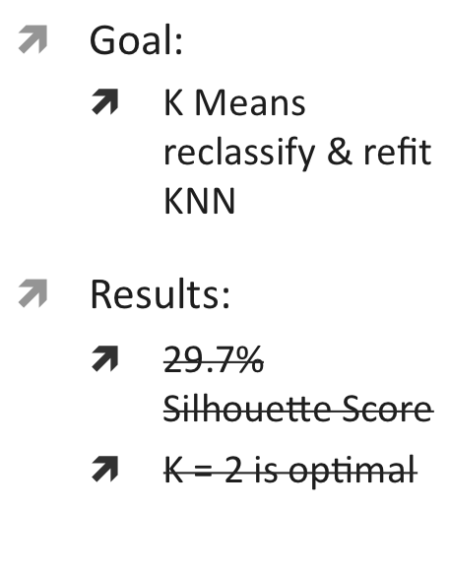
Performance Evaluation
Approach #1
Approach #2
Approach #3
Target Parameters:
  23 subgenres given
Results:
  4.3% Baseline Accuracy
  30.4% Model Accuracy
    7x More Accurate!
Target Parameters:
  8 subgenres made manually
Results:
  30.4% Baseline Accuracy
  47.7% Model Accuracy
    1.5x More Accurate

Slide 12
Impact
Genre Prediction & Classification
  Recommendation Engines:
    Spotify Autoplay
    Pandora Radio
    Playlist Curation
    Background Music in Retail Stores
  Business Opportunities:
    Join with Acoustics by Venue for suitable listening
    Join with brain behavior to apply Music Therapy
    Another way to look at composing by subgenre

Slide 13
Recommendations & Next Steps
Spotify API
Music Genome Project
Join compatible data types to extend new business opportunities

Slide 14
Sources
Title Image: Rave Jungle
  URL: https://www.ravejungle.com/2017/11/20/top-ten-djs-philadelphia-edm-scene/
Data Set: Posted in Kaggle by Caparrini
  URL: https://www.kaggle.com/caparrini/beatsdataset
Feature Documentation & Images: Theodoros Giannakopoulos
  URL: https://github.com/tyiannak/pyAudioAnalysis/wiki/3.-Feature-Extraction

Slide 15
Thank You

